Slide 1

Deep Learning - 2
Machine Learning for Chemistry and Drug Design
Maitreya Maity
IHUB-DATA, IIIT Hyderabad

Slide 2


Plans for today
Bias and Variance Dilemma
Deep Learning
Activation Function
Loss Function
Layers
Optimizer
Regularization
Example

Slide 3
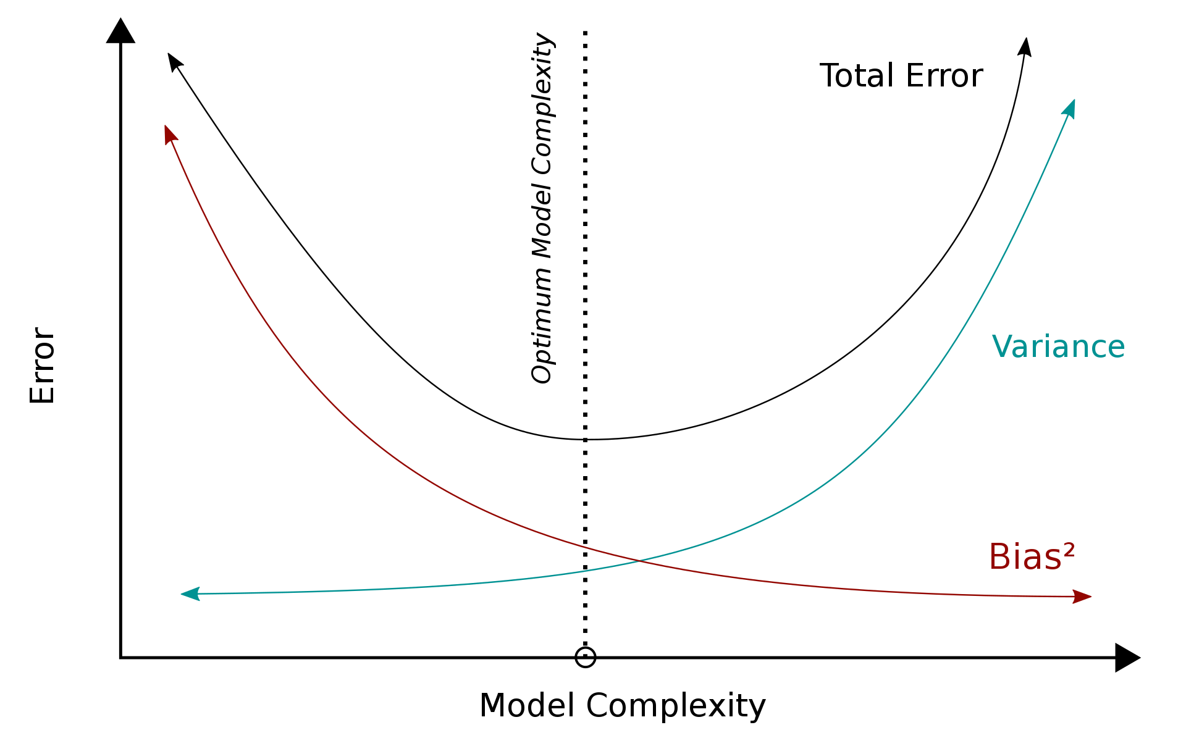
Bias and Variance Dilemma
Ideally, a model would capture the regularities in its training data while simultaneously generalizing well to test data (low bias and a low variance)
Bias
Bias error is the difference between the prediction by the model to the correct value
A model with a high bias ignores the training data, oversimplifying the model
It is referred to as under-fitting because it does not learn the training data well
Variance
Variance of the model is the variability of model prediction for a given data point, which tells about the spread of training data
Model with high variance has a very complex fit to the training data and thus is unable to fit accurately on new data
A model with high variance is referred to as overfitted
Bias and variance are inversely connected
Optimal model is the one that has the best trade-off between bias and variance
* Image courtesy: Wikipedia

Slide 4
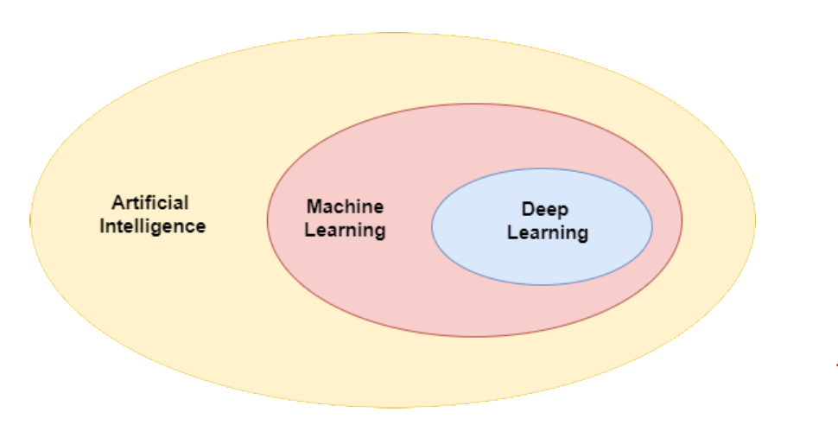
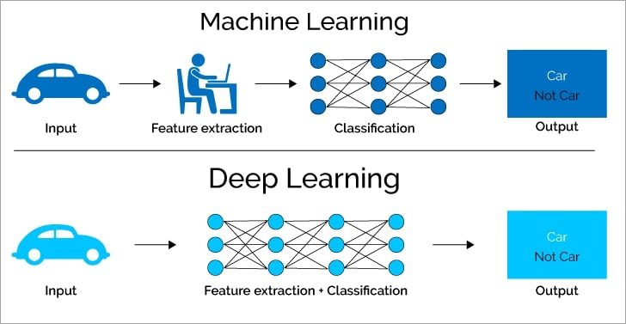
Deep Learning
Deep learning (DL) is a specialized subset of Machine learning
Imitate the data processing function of the human brain
Relies on a layered structure of algorithms called an artificial neural network (ANN)
ANN with two or more hidden layers is referred to as a deep neural network
* Image courtesy: https://deepai.org/machine-learning-glossary-and-terms/perceptron

Slide 5
Advantages of Deep Learning
Handle unstructured data
Feature generation automation
Improved self-learning capabilities
High-quality results
Cost effectiveness
Scalability

Slide 6
Deep Learning Architectures
Deep Learning Architecture
Supervised
Convolution neural network
Recurrent neural network
Unsupervised
Self organization map
Autoencoders

Slide 7
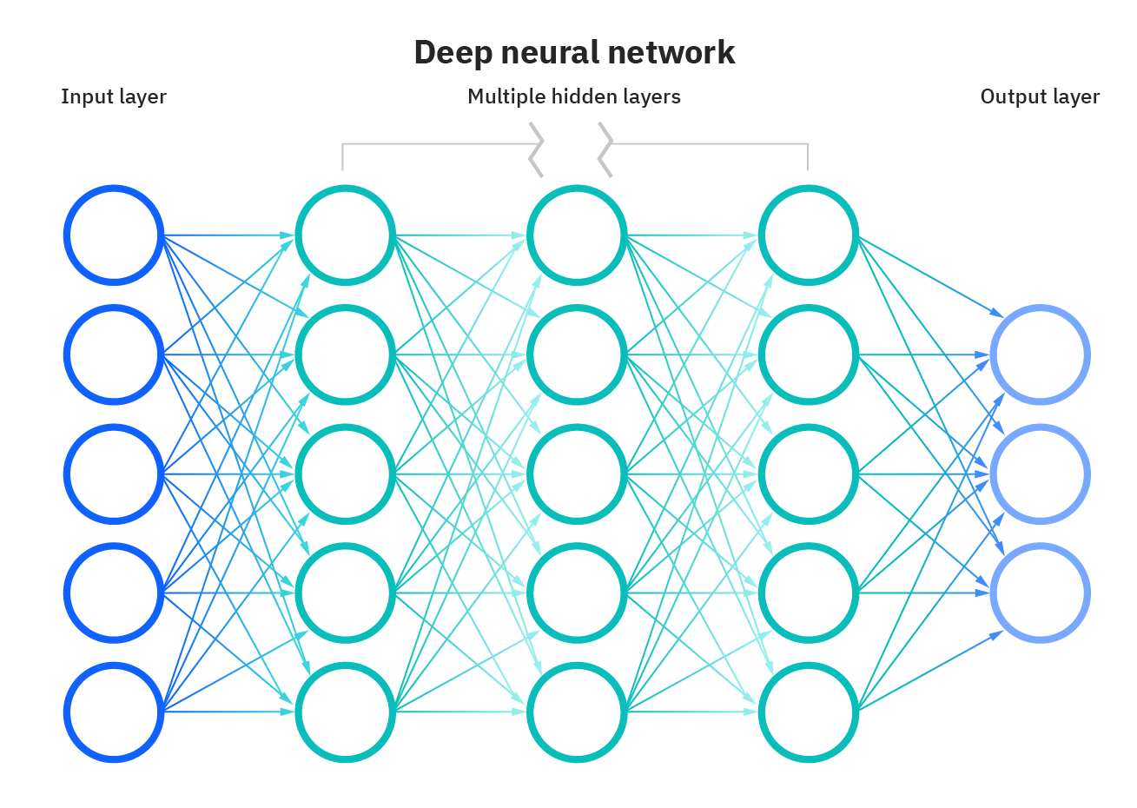
Deep Neural Network
* Image courtesy: https://www.ibm.com/cloud/learn/neural-networks

Slide 8
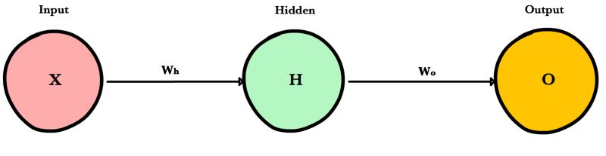

Deep Neural Network
Forward propagation
Weight and bias initialized
Information flows forward to compute predictions and the error
The input data is forwarded layer by layer across the network to the final layer, which generates a prediction
Prediction = g(g(XW_{h})W_{o})
g() = activation function, X= input, W_{h} , W_{o} = weights
Backward propagation
Backpropagation algorithm computes the error derivatives and updates the network weights
Gradient descent
$$w_{new}=w−μ\frac{∂E}{∂w}$$
* Image courtesy: https://ml-cheatsheet.readthedocs.io/en/latest/forwardpropagation.html

Slide 9
Activation Functions
Activation function performs transformation of the summed weighted input (neuron)
Build a complex non-linear relationships
Continuously differentiable
Squash input data into a narrow range

Slide 10
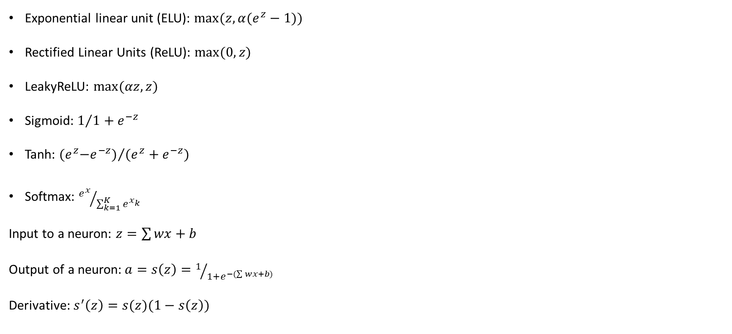
Activation Functions
Exponential linear unit (ELU): $max⁡(z,α(e^{z}−1))$
Rectified Linear Units (ReLU): $max⁡(0,z)$
LeakyReLU: $max⁡(αz,z)$
Sigmoid: $1/{1+e^{−z}}$
Tanh: ${{(e}^{z}−e^{−z})}/{(e^{z}+e^{−z})}$
Softmax: ${e^{x}}/{\sum_{k=1}^{K}{e^{x_{k}}}}$
Input to a neuron: $z=\sum{wx}+b$
Output of a neuron:$a=s\left(z\right)=1/{1+e^{−(\sum{wx}+b) }}$
Derivative: $s^{′}\left(z\right)=s(z)(1−s\left(z\right))$

Slide 11
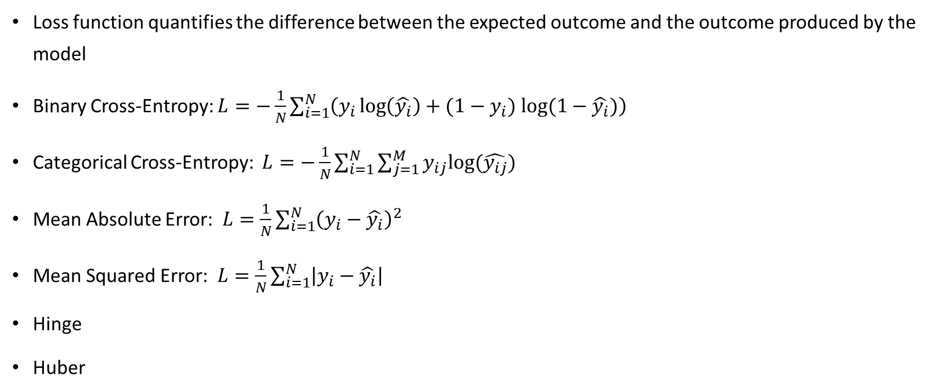
Loss Functions
Loss function quantifies the difference between the expected outcome and the outcome produced by the model
Binary Cross-Entropy: $L=−\frac{1}{N}\sum_{i=1}^{N}{\left(y_{i}\log\left(\hat{y_{i}}\right)+(1−y_{i}) log⁡(1−\hat{y_{i}})\right)}$
Categorical Cross-Entropy: $L=−\frac{1}{N}\sum_{i=1}^{N}{\sum_{j=1}^{M}{y_{ij}log⁡(\hat{y_{ij}})}}$
Mean Absolute Error: $L=\frac{1}{N}\sum_{i=1}^{N}{{\left(y_{i}−\hat{y_{i}}\right)}^{2}}$
Mean Squared Error: $L=\frac{1}{N}\sum_{i=1}^{N}{\left|y_{i}−\hat{y_{i}}\right|}$
Hinge
Huber

Slide 12
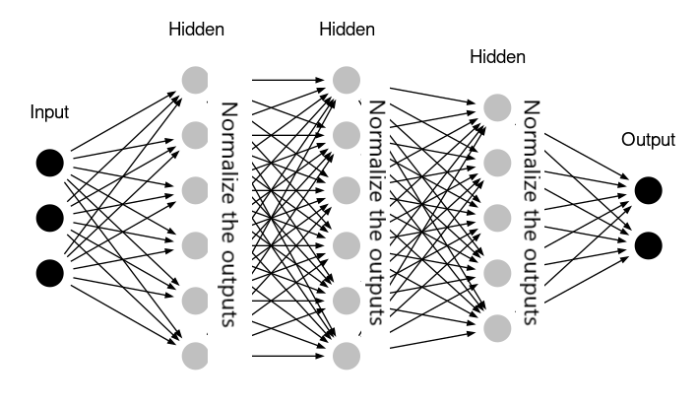
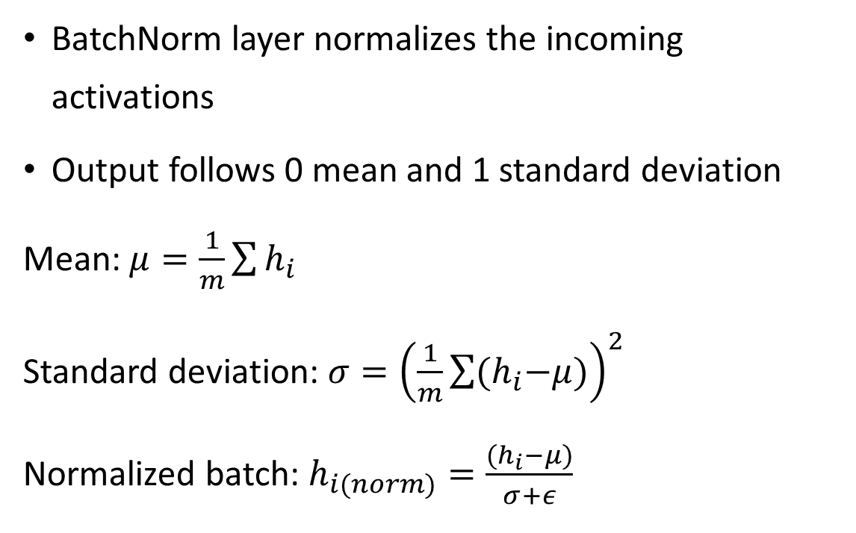
Layers – Batch Normalization
BatchNorm layer normalizes the incoming activations
Output follows 0 mean and 1 standard deviation
Mean: $μ=\frac{1}{m}\sum{h_{i}}$
Standard deviation: $σ={\left(\frac{1}{m}\sum{{(h}_{i}−μ)}\right)}^{2}$
Normalized batch: $h_{i(norm)}=\frac{{(h}_{i}−μ)}{σ+ε}$
* Image courtesy: https://analyticsindiamag.com/hands-on-guide-to-implement-batch-normalization-in-deep-learning-models/

Slide 13
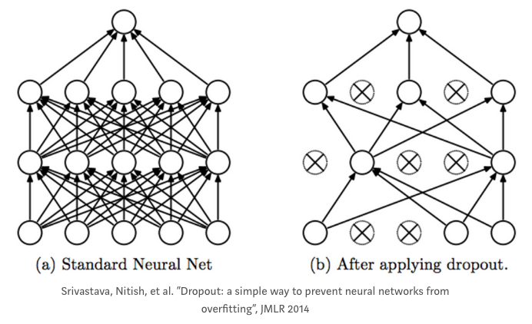
Layers – Dropout
Randomly sets activations to 0, cancelling or dropping
A certain fraction (dropout rate)

Slide 14

Overfitting and Regularization
Data Augmentation
Dropout
Early stopping
Noise
L1 and L2 Regularization
$Loss=Error\left(y−\hat{y}\right)+γ\sum{\left|w\right|}$ , $Loss=Error\left(y−\hat{y}\right)+γ\sum{w_{i}^{2}}$
$$w_{new}=w−μ∆Loss$$

Slide 15
Underfitting
Increase the size of the training sample
Increase the complexity, and parameters in the model
Increasing the duration of training
Decrease regularization
* Image courtesy: https://ml-cheatsheet.readthedocs.io/en/latest/forwardpropagation.html

Slide 16
Hyperparameter Tuning
Hyperparameters are a set of variables to determine the model structure (estimator-specific) and training process (algorithm-specific)
These parameters are adjusted before model training initiation
Hyperparameters - number of hidden layers, learning rate, momentum, activation function, dropout, epochs, etc.
Optimization techniques - Grid search and Random search
Keras-tuner, Hyperas, etc. libraries are used for hyperparameter tuning

Slide 17
Code Implementation

Slide 18
Thank you

